Slide 1

AI Physical Agents
CSE 564 Software Design
Abhishek, Abhijith, Anant, Ankit, Ismael, Manju, Prateek, Shibani and Vachan
Notes:
Look at the notes on slide 2 please

Slide 2
Agenda
1.- Intro
2.- Collective Robot Reinforcement Learning with Distributed Asynchronous Guided Policy Search.
3.- Deep Reinforcement Learning for Robotic Manipulation.
4.- Deep Visual Foresight for Planning Robot Motion.
5.- Conclusion
6.- Future work
Notes:
The point 2 is not in sync with the next two
All 0 learning and robotic motion/manipulation, but point two mentions the policy in the title
Either we mention all policies or just all motions

Slide 3
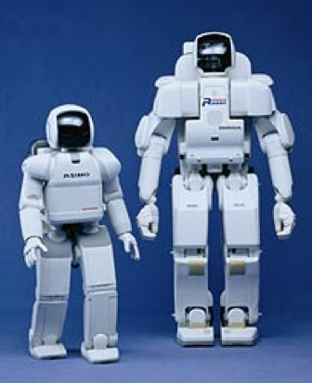
AI Agents vs AI Tools
The term ROBOT, Czech word - ‘robota’
What does it mean?
A robot is: “An active artificial agent whose environment is the physical world”
 | AI Agent | AI Tool
Takes responsibility | ✔ | ✘
Takes Initiative | ✔ | ✘
Interact on behalf of a client | ✔ | ✘
HONDA ASIMO (2000):lAble to walk freely (can change stride speed), Able to balance on one foot,Able to climb stairs, Able to manipulate objects, Space- & cost-efficient
Notes:
- Takes responsibility, takes initiative, interacts with others on behalf of a client.
- Responds directly to its user. Does not take responsibility. Does not take initiative. Does not normally interact with others on behalf of a client.

Slide 4
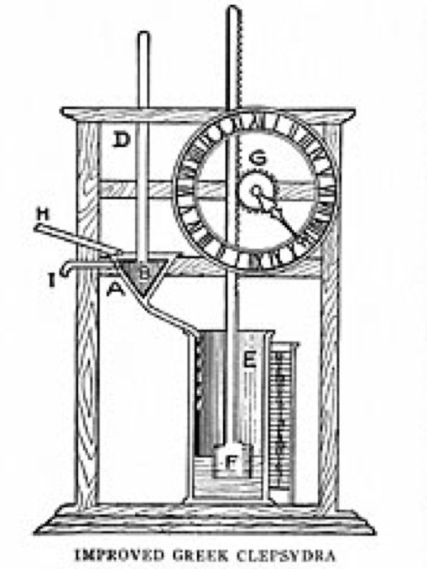
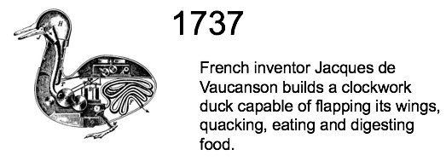
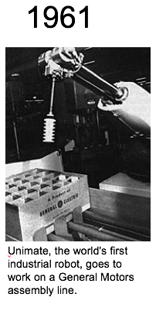
Past to Present
Later Developments include:
Robot Assisted Surgeries
Military Robots
Swarm Robotics
Nanorobotics: close to the scale of a nanometre (10⁻⁹ metres).
Wall-Bot(dry-adhesion), Water-Runner, Slugbot, Ecobot II (Microbial fuel cells, to digest flies!)
1400 BC: Clock that measures time using the flow of water, ‘robotic device’
Notes:
clepsydra, a clock that measures time using the flow of water. It's considered one of the first "robotic" devices in history.
In this case the robot 'hunted' slugs. The collected slugs would be fermented to produce biogas in a separate off-board digester unit. The gas would then be passed through methane fuel cell to generate electricity. The electricity would be stored in batteries and could be downloaded to a 'hungry' robot

Slide 5
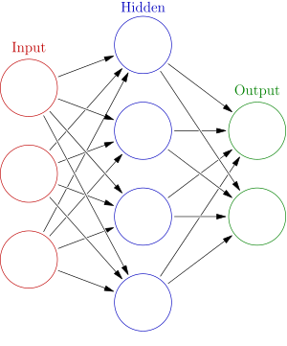
Neural Networks for AI
Artificial Neural Networks defined by 3 parameters:
Interconnection pattern: between different layer neurons
Learning process: to update weights of interconnections
Activation function: converts neuron’s weighted inputs to its output activation
Reinforcement Learning done using ANNs
Artificial Neural Network ([1])

Slide 6
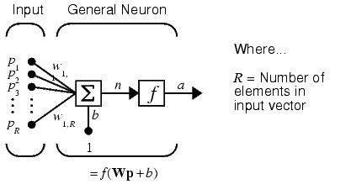
A single neuron(perceptron)

Slide 7
Global and local workers
Global workers build the experience data
The global workers improve all local workers marginally
Local workers build replay models.
Each robot has a local worker that ensures that different robots behave for their purposes. Their global worker exchanges information.

Slide 8
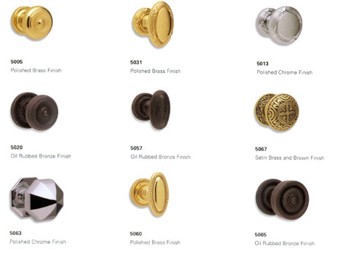
Multiple Robots
While the global policy is optimized in the background. This system also makes it easy to add multiple robots into the training process, The local worker is pliable.

Slide 9
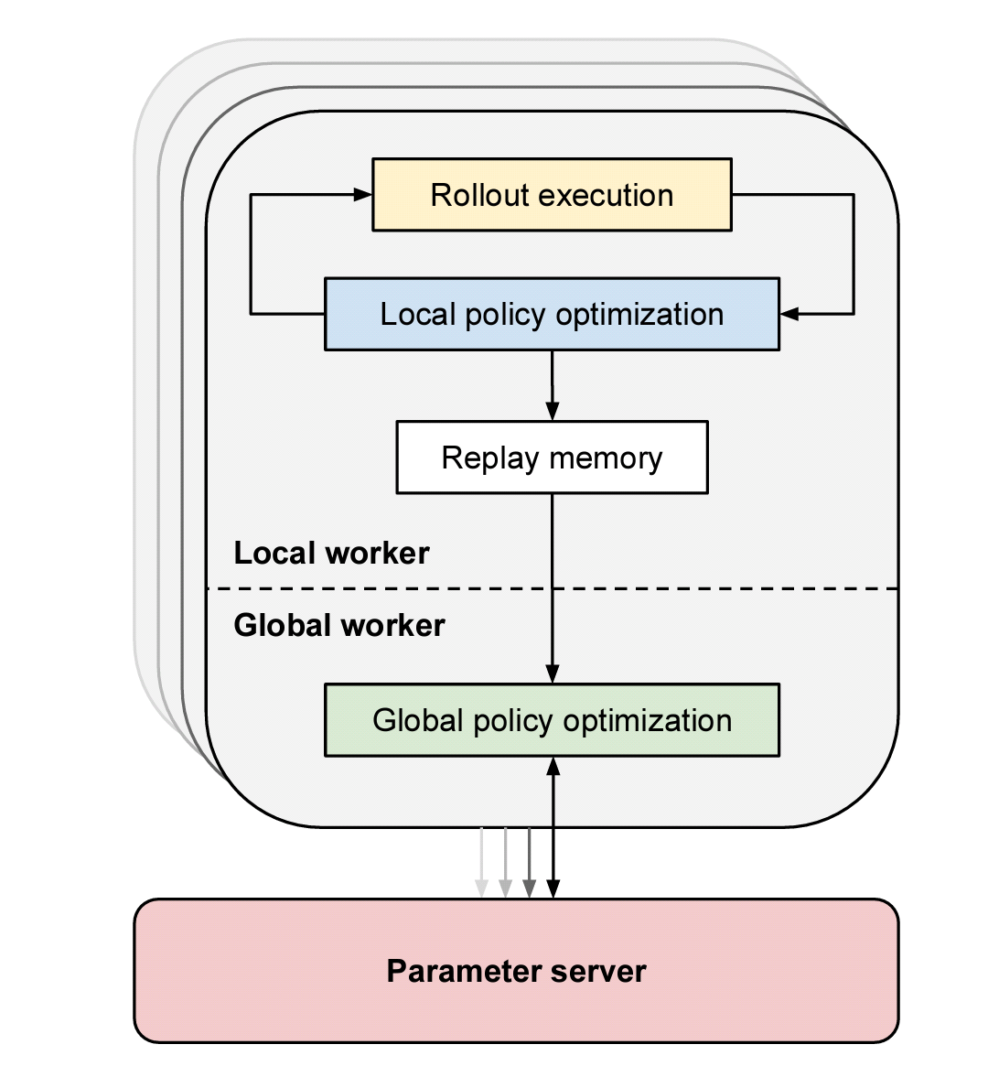
Interaction Diagram
Only information deemed valuable for every worker will be relayed to the global worker. This happens less frequently

Slide 10
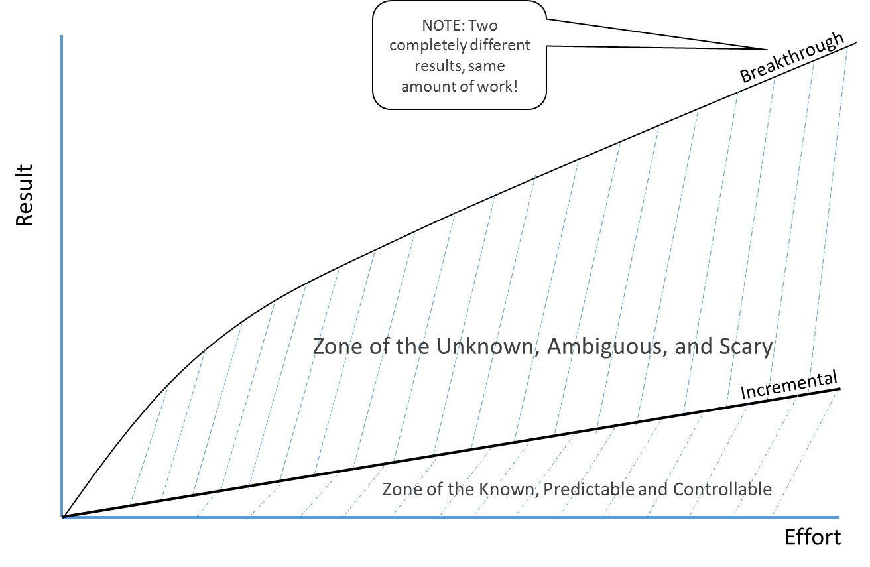
Training Frequency
The global worker can be given updates at a different frequency than the local worker.
In in the door handle example, the local workers can be updated frequently.

Slide 11
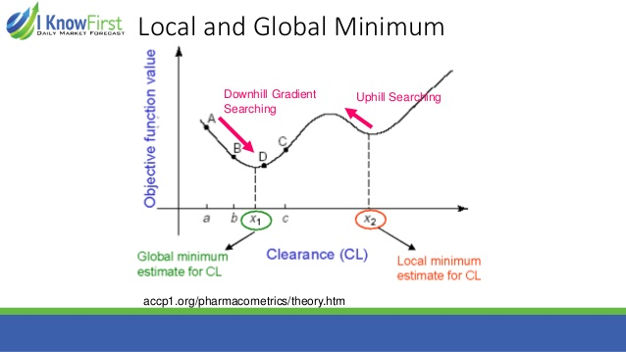
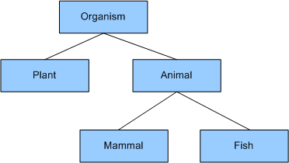
Machine Learning Hierarchy
• Local algorithms zoom in on optima based on known information • Global algorithms must also have a component of exploring new regions in design space • The key to global optimization is therefore the balance between exploration and exploitation • Many accomplish that based on population

Slide 12
Experimental Evaluations
Experimental Evaluations aims answering two questions:
Does distributed asynchronous learning accelerate the training of neural network policies?
Does training across group of multiple robots improve the generalization of the resulting policies?

Slide 13
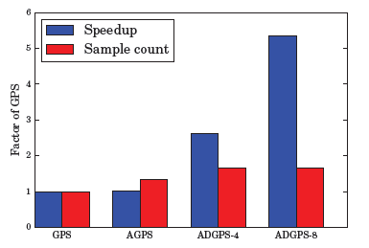
Experimental Evaluations
Simulated Evaluation:
Systematically varying the number of robots to evaluate the training times scale, as well as studying the effect of asynchronous training.
This approach can reduce training times.

Slide 14
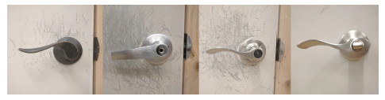
Experimental Evaluations
Real-World Evaluation:
Vision Based Door Opening policy.
Aims that distributed asynchronous system can effectively learn neural network policies using visual inputs.

Slide 15
Experimental Evaluations
Distributed Asynchronous Policy learning with multiple robots can be used as single generalized skill.
Neural Network Policies trained by robots continuously collecting new experiences.

Slide 16
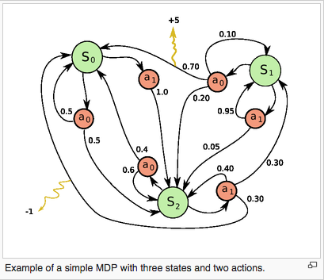
Reinforced Learning (NAF-Q Learning)
Neural Networks are being used for:
Locomotion
Manipulation (Learning Hand-Eye Co-ordination for Robotic Grasping[2])
Autonomous Vehicle Control
Deep Q-functions: (a combination of states, actions and rewards, with the aim of maximizing rewards) [3]
Notes:
Paper 2 : Anant 1:30-3:00 policy NAF

Slide 17
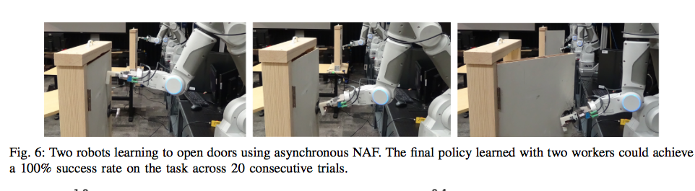
Reinforced Learning (NAF-Q Learning)
Achieve efficiency by multithreading.
2 types of threads (learner, worker)
Asynchronous updates from the deep core to The nodes.
Safety Constraints
Learns to open a door in 2.5 hours! Ironic?
Notes:
Paper 2 : Anant 1:30-3:00 safety constraints : maximum commanded velocity per joint, position limit and bounding sphere for end effector position.
Trained and tested initially by MuJoCo physics simulator (Open Source)

Slide 18
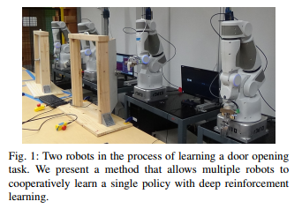
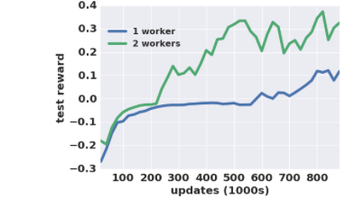
Reinforced Learning (NAF-Q Learning)
Notes:
Paper 2 : Anant 1:30-3:00

Slide 19
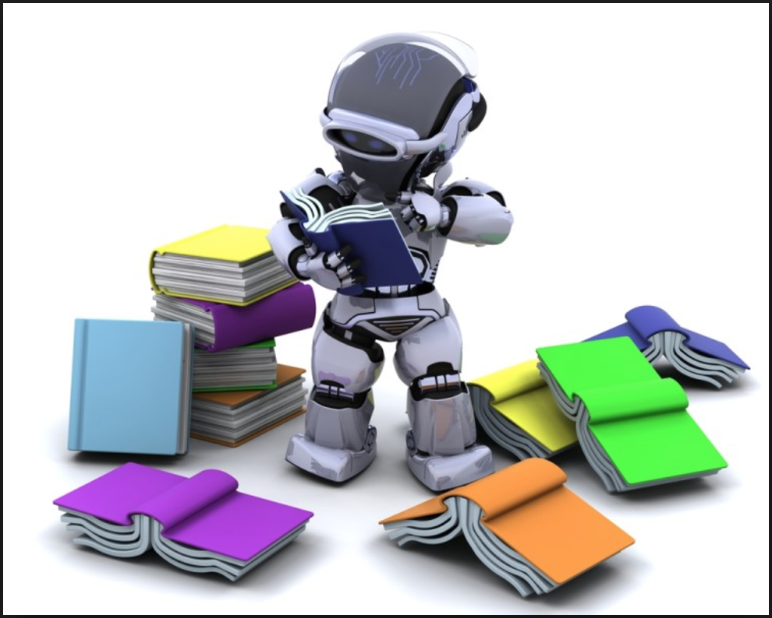
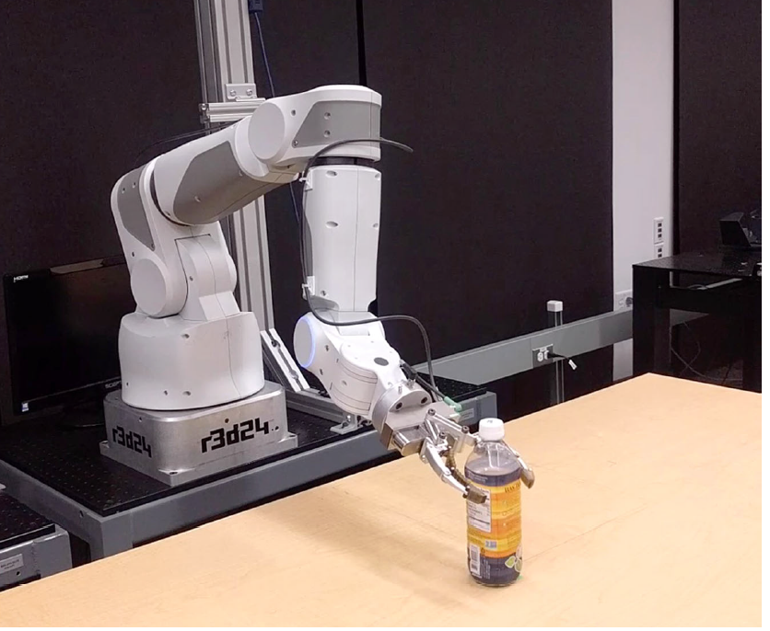
Predictive Model
How can AI physical agents learn without human supervision?
Notes:
Paper 3 : Manju 3:00

Slide 20
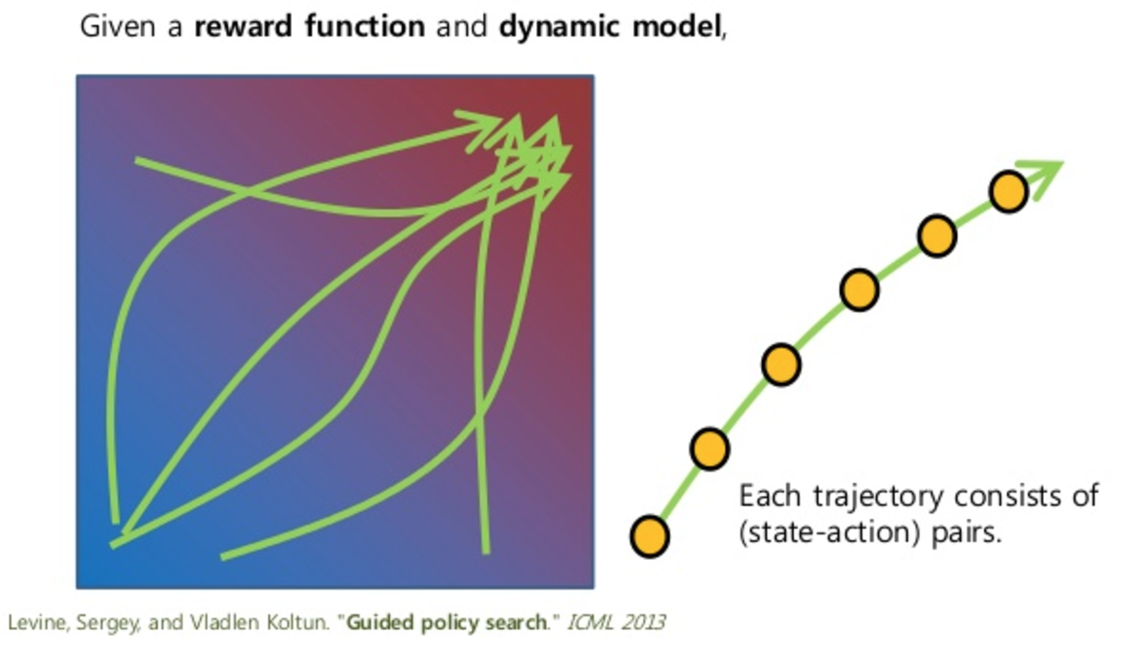
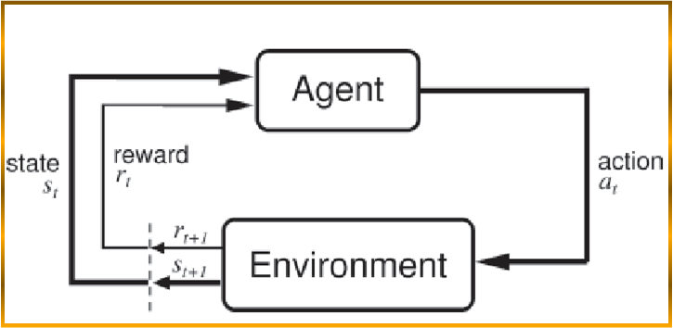
Predictive Model
Reinforcement Learning
Guided Policy Search
Notes:
Paper 3 : Manju 3:00

Slide 21
Predictive Model
What is Model Predictive Control learning?
Perception
Prediction
Learning
Notes:
Paper 3 : Manju 3:00

Slide 22
Experimental Setup
7-DoF robot arm, an RGB camera.
The pushing task - episodes of length T = 15, to move M pixels from their current locations
New controls computed about every 200 ms.
Notes:
Paper 3 : Abhijeet 3:00

Slide 23
Three Baselines
Select actions randomly from a uniform distribution.
Servo the end-effector to the goal pixel position, using a known camera calibration.
Servo the end-effector along the vector from the current pixel position to the goal, with continuous replanning using optical flow.
Notes:
Paper 3 : Abhijeet 3:00

Slide 24
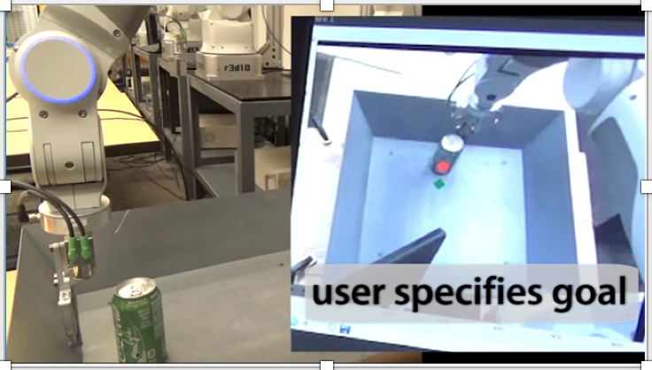
Results
Notes:
Paper 3 : Abhijeet 3:00

Slide 25
Limitations
Handling self occlusions.
Incorrect model predictions also cause failures in performance.
Notes:
Paper 3 : Abhijeet 3:00

Slide 26
Conclusion
We looked at
How Neural Networks is being used for training the robots.
How multiple robots work together
Reinforced Learning
Predictive Model

Slide 27
Current limitations of AI Agents
What do AI agents lack?
What feature will enable a widespread usage of AI Agents

Slide 28
Current limitations of AI Agents
Common Sense

Slide 29
How can AI Agents have Common Sense?
Is it Possible?
They need the following to work perfectly and come close to having common sense:
A large Database containing knowledge of how things work in the world.
Ability to learn and teach each other like Humans
Ability to understand the contexts and respond accordingly

Slide 30
Is it Possible?
A large database containing knowledge of how everything in our world works?
Ability to teach and learn from each other?
Global and Local learners
Ability to understand contexts and respond accordingly?
Neural Networks

Slide 31
What is the Future of AI?
Currently in the era of self driven cars, personal assistants etc.
Jurgen Schmidhuber, father of deep learning says, ‘By the year 2050, self-replicating robot factories will be present on the asteroid belt’.[4]
Space exploration
Notes:
Abhishek just check this out for future works: “AI Will Colonize the Galaxy by the 2050s, According to the “Father of Deep Learning” [4b] - an overstatement?” Check reference link 4b for this, I had this in intro, but it should be mentioned for future work. The following bullet points are related too:
Jürgen Schmidhuber asserts that, by 2050, there will be trillions of self-replicating robot factories on the asteroid belt.
In a few million years, robots will naturally explore the galaxy out of curiosity, setting their own goals without much human interaction.

Slide 32
Can AI be smarter than the humans?
By 2050, world be filled with intelligent robots
Google’s future plans
Going by the trend, robots will start to behave like humans very soon
Emotions, Intelligence and self replication

Slide 33
References
1. https://arxiv.org/pdf/1610.00633v1.pdf
2. https://arxiv.org/pdf/1603.02199.pdf
3.http://futurism.com/dawn-of-synthetic-reason-deepmind-can-learn-from-its-own-memory/
4.http://futurism.com/ai-will-colonize-the-galaxy-by-the-2050s-according-to-the-father-of-deep-learning/
5.https://arxiv.org/pdf/1610.00673v1.pdf
6.https://arxiv.org/pdf/1610.00696v1.pdf

